Slide 1
Modelica Project Midterm
Chris Arun Muralitharan, Fredrik Heimstad, Håkon Yssen Rørstad, Christofer Gilje Skjæveland, Lars Mansåker Angelsen
Group 28

Slide 2
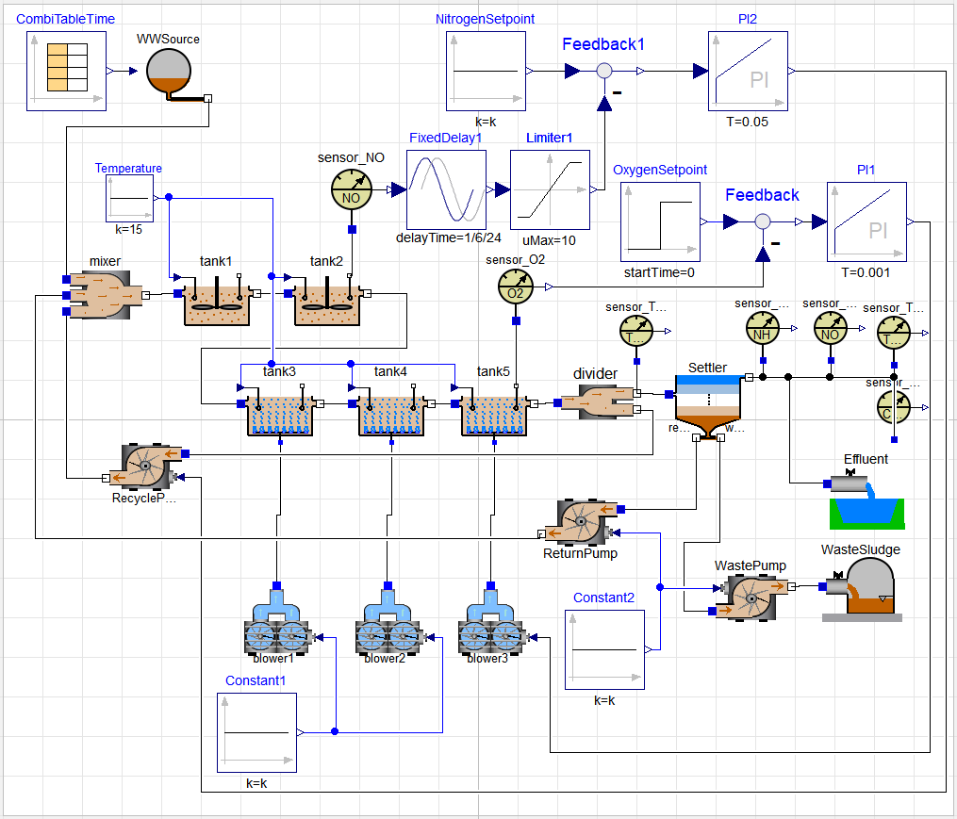
Assignment 1
Objective: Develop a plant for BSM1 from the plant for ASM1

Slide 3
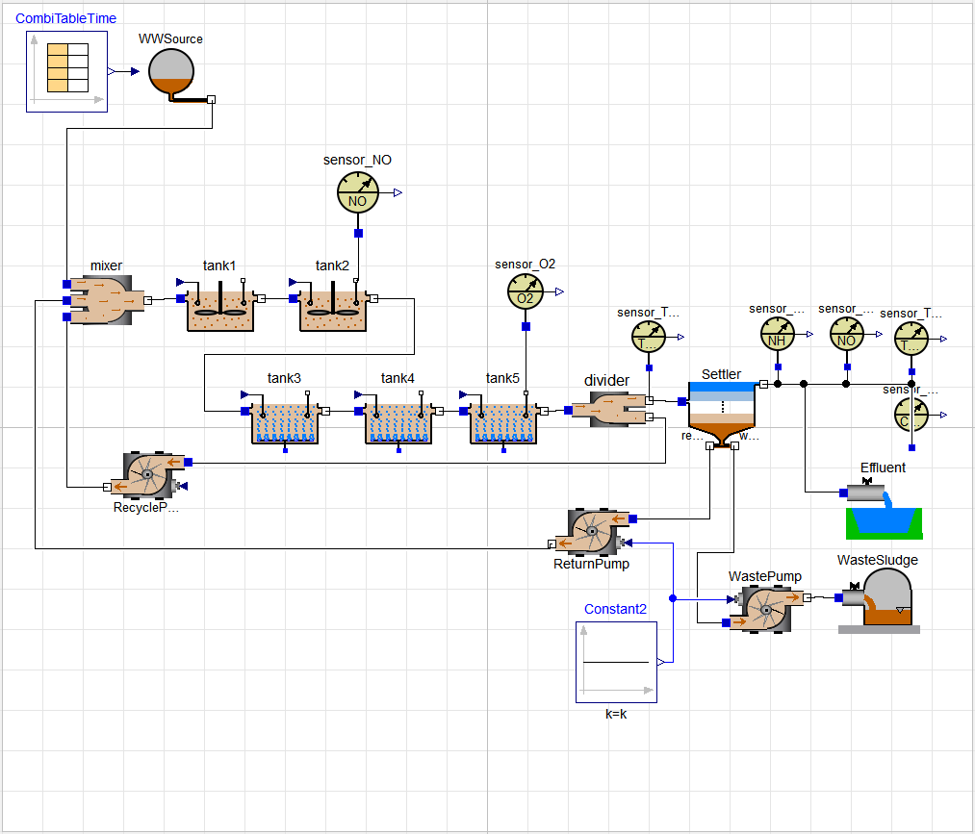
Assignment 1
Objective: Develop a plant for BSM1 from the plant for ASM1

Slide 4
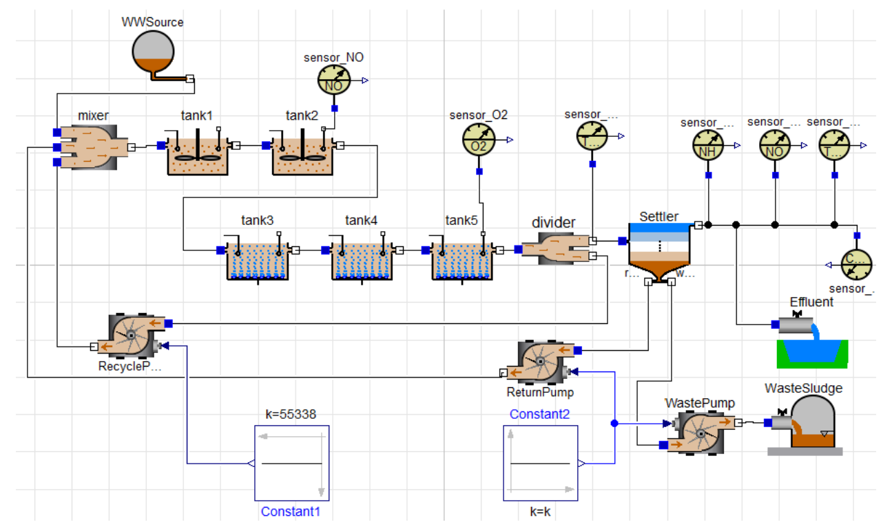
Assignment 2
Objective: Implement a dynamic open-loop simulation of BSM 1

Slide 5
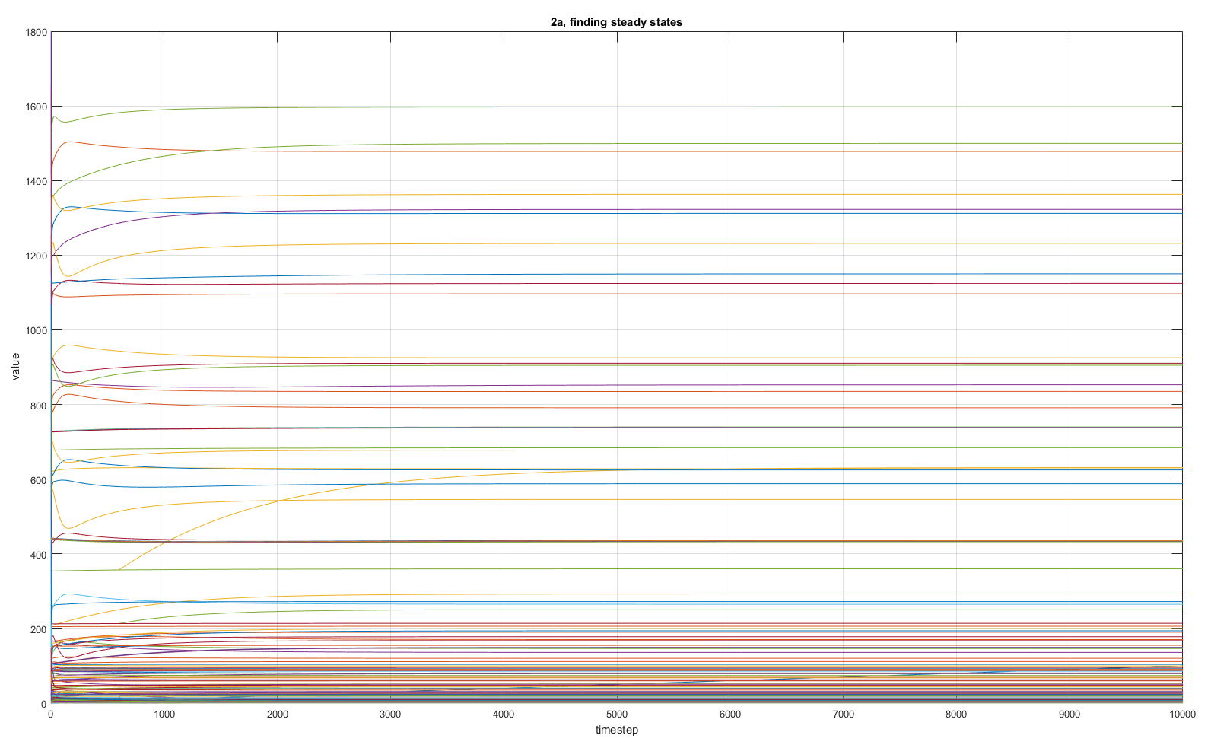
Assignment 2
Objective: Implement a dynamic open-loop simulation of BSM 1

Slide 6
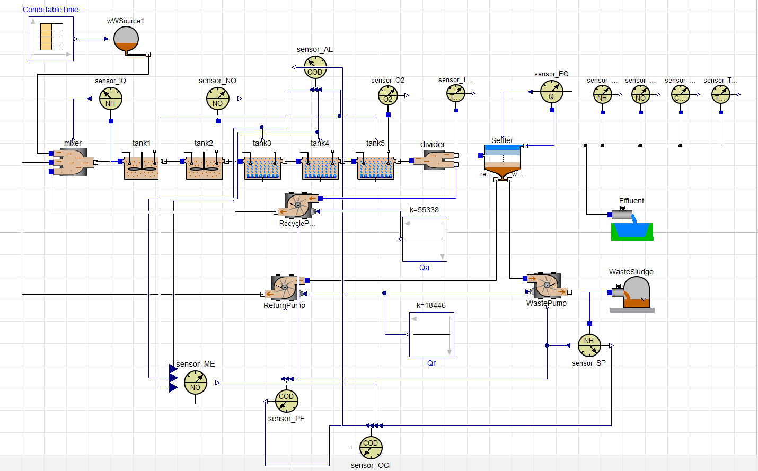
Assignment 3
Objective: Implement sensors for the performance parameters:
EQ, PE, AE, IQ, SP.

Slide 7
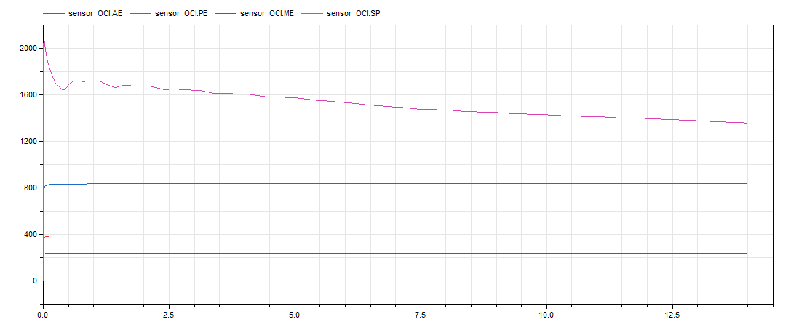
Assignment 3
Objective: Implement sensors for the performance parameters:
EQ, PE, AE, IQ, SP.

Slide 8
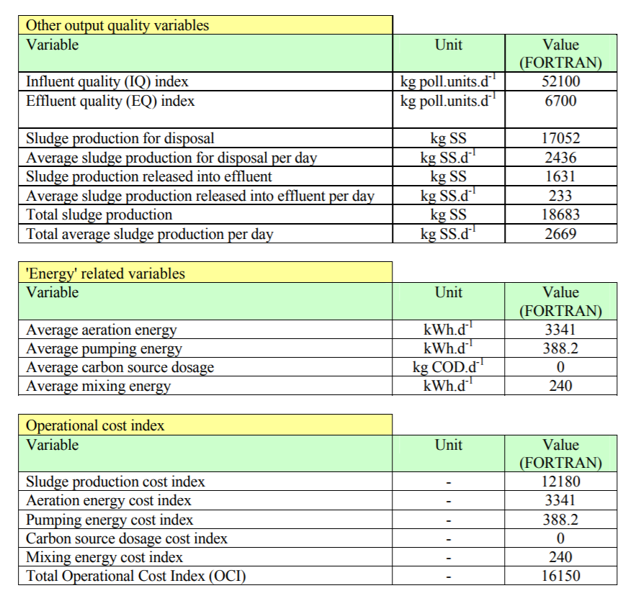
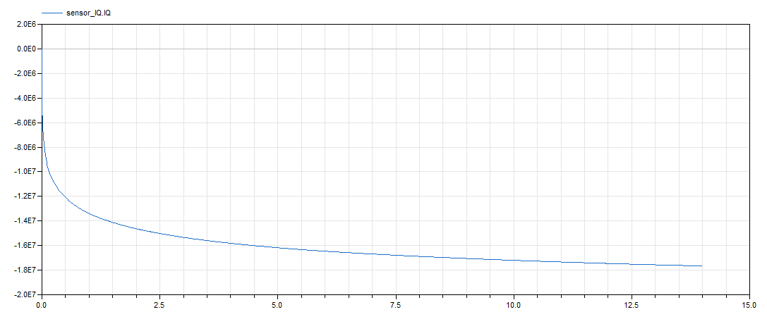
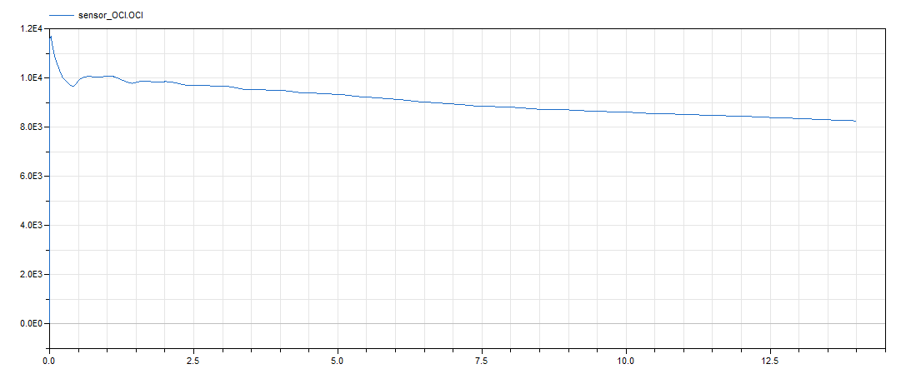
Assignment 4
Objective: Implement sensors for the performance indicators ME
and SP. Calculate the overall cost indicator (OCI).

